Slide 1
Prep clinic presentation: manual development
By Lenee Powell-Wilson, MPA, BSN, RN
University of Illinois at Chicago
This tool has been prepared by Lenee Powell-Wilson, owner. Permission to modify, distribute, or use this tool must be provided in advance. The owner has the right to refuse requests. Requests can be sent via email to lpowel21@uic.edu. Illegal use could lead to legal action.

Slide 2
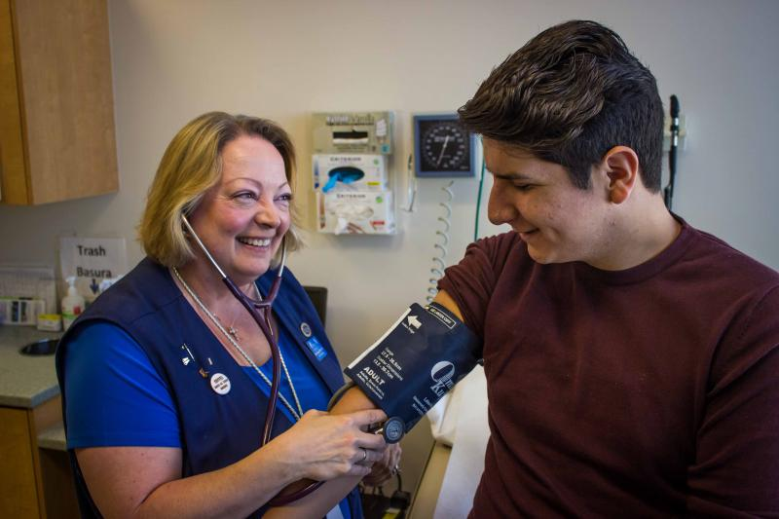
Clinical Issue/
Practice Problem
To produce a sustainable operational policy manual for staff to follow in efforts of reducing daily work practice inconsistencies to deliver safe and reliable care.

Slide 3
STAKEHOLDER PRESENTATION CONTENT
Manual Structure
Content evidence
acknowledgements
IMPACT/recommendations
Manual Structure
acknowledgements
IMPACT/recommendations
Content evidence

Slide 4
MANUAL STRUCTURE
Table of Content
Includes 8 sections with subsections
Easily identifies page numbers of the 8 sections and subsections
Sections & Subsections Structure
Content is categorized by 8 sections:
1.0 PREP CLINIC OVERVIEW
2.0 CLINIC OPERATIONS
3.0 VISIT PROCESSES
4.0 SCHEDULING
5.0 MEETINGS/REPORTING
6.0 STAFFING MANAGEMENT
7.0 ELIGIBILITY/FINANCE
8.0 REGULATION

Slide 5
MANUAL STRUCTURE
CONT’D….
Proven and/or regulatory content will be referenced after each subsection.
Referenced sections will be denoted with a short line and then a short
reference to the full reference located in the Reference section of the manual.
Example:
_____________________________
(ABC Reference (20XX)
Appendix
References

Slide 6
MANUAL STRUCTURE
There are sections that require stakeholder updates and input. These are denoted by:
Additional content available in clinical manual
Clinic will update this section as appropriate.

Slide 7
CONTENT EVIDENCE
How did I develop the operations manual?
Researched nationally recognized websites and industry approved standards.
HIV.gov
Center for Disease Control & Prevention (CDC)
Getting to Zero Illinois
World Health Organization (WHO)
Learned about the medication.
Attended stakeholder meetings.

Slide 8
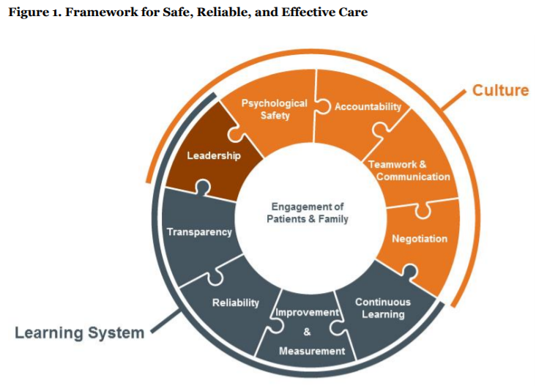
CONTENT EVIDENCE
Theoretical Framework
Institute for Health Improvement’s (IHI)
Framework for Safe, Reliable, and Effective Care
Figure 1.
Framework for Safe, Reliable, and Effective Care
Note: IHI’s Framework for Safe, Reliable, and Effective Care. Reprinted from “Frankel A, Haraden C, Federico F, & Lenoci-Edwards J. A Framework for Safe, Reliable, and Effective Care. White Paper. Cambridge, MA: Institute for Healthcare Improvement and Safe & Reliable Healthcare; 2017.”

Slide 9
CONTENT EVIDENCE
Proven Research Implications:
maintaining staff teamwork, delivering reliable and consistent proven service, providing positive patient experiences, increasing patient safety, and improving employee satisfaction and retention
Alayhya et al. (2018) - policies were more effective when there were limited barriers, such as lack of knowledge, leading to employee engagement and policy adherence
Katou and Budhwar (2010) - policies build employees with ability, motivation and opportunity to make adequate decisions and exhibit discretionary behaviors
Mohr and Young (2013) - policy manuals have been linked to positive patient satisfaction, safety and outcomes which can be as a result of staff teamwork
Shaw et al. (2013) – clear policies and expectations available for staff to reference and review, regardless of role experience, resulted in effective health outcomes
(Alayhya et al., 2018, Katou and Budhwar, 2010, Mohr and Young, 2013, Shaw et al., 2013)

Slide 10
CONTENT EVIDENCE
CENTER
ON
HALSTED
Compared similar clinics including:
Center on Halsted – Chicago, Illinois
Gay City – Seattle, Washington
Grady Hospital – Atlanta, Georgia
Family Health Center – Kalamazoo, Michigan
Cares – Southwest Michigan

Slide 11
CONTENT EVIDENCE
Researched content:
Illinois General Assembly
Administrative Code
Statues
Agency for Healthcare Research and Quality
Centers for Disease Control & Prevention
Center for Medicaid and Medicare Services
Getting to Zero Illinois
HIV.gov
Illinois Department of Human Services
National Institute of Health
Occupational Safety and Health Administration
Public Health Institute of Metropolitan Chicago
U.S. Public Health Service
Patient Centered Medical Home (PCMH) Standards & Guidelines

Slide 12
IMPACT/RECOMMENDATIONS
IMPACT:
The operations manual will provide and maintain safe, reliable and effective clinic operations by:
promoting a culture of teamwork
practicing evidence-based and regulatory processes that follow proven standardization and governmental expectations
providing transparency for practice adherence
delivering a tool for employees to make responsible decisions and exhibit discretionary behaviors
avoiding diagnostic failures leading to patient harm
(Shaw et al., 2013; Alyaha et al., 2018; Katou and Budhwar, 2010)

Slide 13
IMPACT/RECOMMENDATIONS
RECOMMENDATIONS:
Opportunities recommended for stakeholders include:
making the manual web based for user friendly access
partnering with behavioral health providers
reviewing and critiquing the manual at least annually
incorporating regulatory updates
maintaining metric analysis for patient care improvement
considering accreditation to
keep stakeholders and staff accountable to quality improvement
promote the clinic’s dedication to safe patient care
Strengthen the adherence to proven evidence and expectations of quality care

Slide 14
ACKNOWLEDGEMENTS: ACADEMIC INSTRUCTORS
Dr. Sheryl Stogis, DrPH, RN – Faculty Mentor – UIC College of Nursing
Dr. Karen Cotler, DNP, FNP-BC, FAANP – Project Mentor – UIC College of Nursing
Thank you for introducing me to this project and allowing me to explore the world of HIV prevention. I appreciate the opportunity to create this manual for the Center on Halsted PrEP Clinic.

Slide 15
ACKNOWLEDGEMENTS: PROJECT STAKEHOLDERS
Thank you for allowing me to compile evidence-based processes and regulations with processes conducive to the COH PrEP clinic. My experiences have given me the opportunity to learn about HIV prevention and regulatory standards for outpatient care.

Slide 16
ACKNOWLEDGEMENTS: COMPARISON PREP CLINICS
Name | Locations for Services | Program Affiliation
Center on Halsted | Chicago, Illinois | University of Illinois Health
Gay City: Seattle’s LGBTQ Center | Seattle, Washington | University of Washington
Grady Hospital | Atlanta, Georgia | Grady Hospital System
Family Health Center | Kalamazoo, Michigan Portage, Michigan | Independent
Cares – Southwest Michigan | Benton Harbor, Michigan Kalamazoo, Michigan | Independent
Thank you for allowing me to discuss their PrEP clinics and processes. I appreciate them sharing their clinics’ content and hope my project will assist their organizations in maintaining an evidence-based operation.

Slide 17
ACKNOWLEDGEMENTS: PROJECT PARTNER
UIC DNP Student preparing the clinical section
Thank you for working with me on this project. I wish her well with the clinical section of the manual and hope our beginnings will prove useful for her final project.

Slide 18
ACKNOWLEDGEMENTS: MUSICAL DIRECTOR
Evan Powell
Thank you for the musical insight and assistance with my project.

Slide 19
THANK YOU

Slide 20
REFERENCES
Alyahya, M., Hijazi, H., Al Qudah, J., Alshyab, S., & Alkhalidi, W. (2018). Evaluation of infection
prevention and control policies, procedures, and practices: An ethnographic study. American Journal of Infection Control, 46; pages 1348-1355, https://doi.org/10.1016/j.ajic.2018.05.023
Frankel A, Haraden C, Federico F, & Lenoci-Edwards J. A Framework for Safe, Reliable, and Effective Care. White Paper. Cambridge, MA: Institute for Healthcare Improvement and Safe & Reliable Healthcare; 2017.
Katou, A. & Budhwar, P. (2010). Causal relationship between HRM policies and organizational performance: Evidence from the Greek manufacturing sector. European Management Journal, 28(1), pages 25-39, https://doi.org/10.1016/j.emj.2009.06.001
Mohr, D., Benzer, J., & Young, G. (2013). Provider workload and quality of care in primary care
settings: Moderating role of relational climate. Medical Care, 51(1), pages 108-114, DOI: 10.1097/MLR.0b013e318277f1cb
Shaw, R., Sweester, C., St. John, N., Lilo, E., Corcoran, J., Jo, B., Howell, S., Benitz, W., Feinstein, B., Melnyk, B., & Horwitz, S. (2013). Prevention of postpartum traumatic stress in mothers with preterm infants: Manual development and evaluation. Journal of Mental Health Nursing, 34(8), pages 578-586, DOI: 10.3109/01612840.2013.789943

